Slide 1















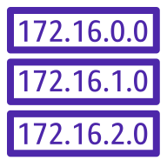




Public Internet
AWS Cloud
Environment specific resources (dev, staging, prod)
DynamoDB:
telemetry-${env}-temperature- readings
DynamoDB:
telemetry-${env}-temperature- readings-aggregation
CW: Log Group
ACM: TLS Certificate
VPC
VPC Endpoint
DNS
Public subnet
Private subnet
Retrieve Certificate
Custom DNS: lucastelemetry3m.com
Inbound and outbound connections
ECS Cluster / Telemetry-App Service
HTTPS
HTTPS
HTTP
Users
Internet Gateway
Application Load Balancer
ECS Task
telemetry_app
Shared resources
Outbound connections only
Route Table
HTTPS (Get Lock)
DynamoDB:
TF Lock
TCP (Pull ECR images)
NAT Gateway
HTTPS (Get State)
github.com/lucasfdsilva/telemetry-app
S3: tfstate
Key
Directly related service
TCP (Pull ECR Images)
Indirectly related service
ECR: telemetry_app

